Slide 1

LennWaJoeC: Chicago Public Schools Achievement Study
How do teacher retention rates affect test scores?
What sort of differences do we see in Charter Schools?

Slide 2
Early stages:
Our team decided to examine the differences between charter schools and neighborhood schools in the Chicago Public School system. We were initially curious about how charter schools might discriminate against special needs kids. This led us to our datasets and transitioned us to different questions.

Slide 3

Data Sources
Chicago Public Schools:
1.) Teacher salary data (2018-2019)
2.) School Progress Report (2018-2019)
https://data.cityofchicago.org/Education/Chicago-Public-Schools-School-Progress-Reports-SY1/dw27-rash

Slide 4
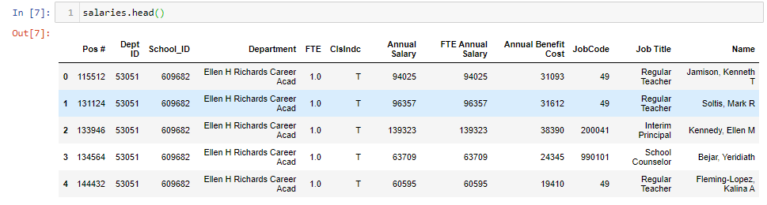
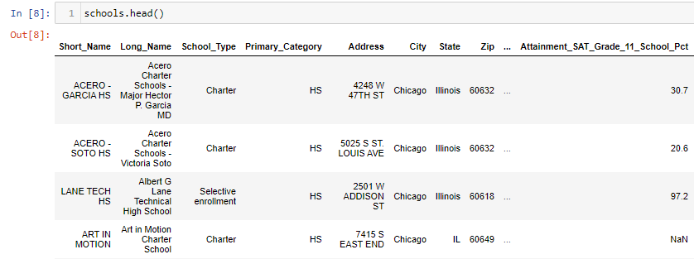
Assembling the Data

Slide 5
Data Sources
Chicago Public Schools:
1.) Teacher salary data (2018-2019)
2.) School Progress Report (2018-2019)
https://data.cityofchicago.org/Education/Chicago-Public-Schools-School-Progress-Reports-SY1/dw27-rash
State of Illinois:
1.) School Snapshots (2018-2019)
https://www.illinoisreportcard.com/School.aspx?source=teachers&Schoolid=15016299025072C
*Note the CPS API is currently not working according to a source in their department

Slide 6
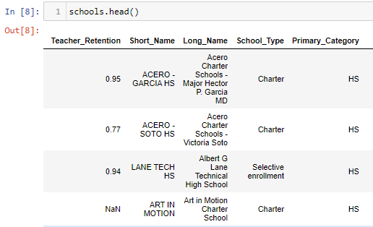
Where did the data take us?
As it turns out, charter schools’ teacher salary data is not publicly available. With further research; however, we discovered teacher retention rates are available on all schools. We then manually entered this data into our dataset.

Slide 7

Final Questions:
Are salaries similar between neighborhood schools and selective/magnet schools?
Does teacher salary/retention have an impact on student performance?
Is performance different at charter schools vs public schools in Chicago?
PSAT attainment 9-11
Growth PSAT 9-11
Graduation 4/5 Yr Percentages
College enrollment
Questions which we decided not to work on:
Are elementary schools ranked lower than high schools in the same neighborhood?
Are the rates of special education schools different across the different types of schools?

Slide 8
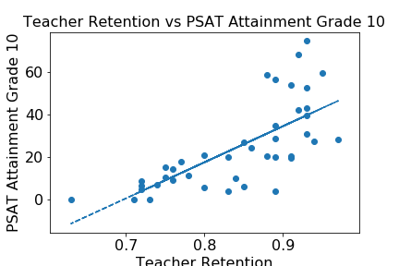
Does teacher retention correlate to student performance? A: Yes, the correlation is .717

Slide 9
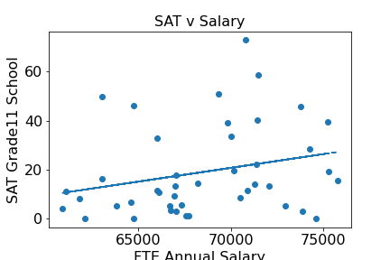
Q: Does teacher salary have an impact on student performance? A: No, correlation is .255

Slide 10
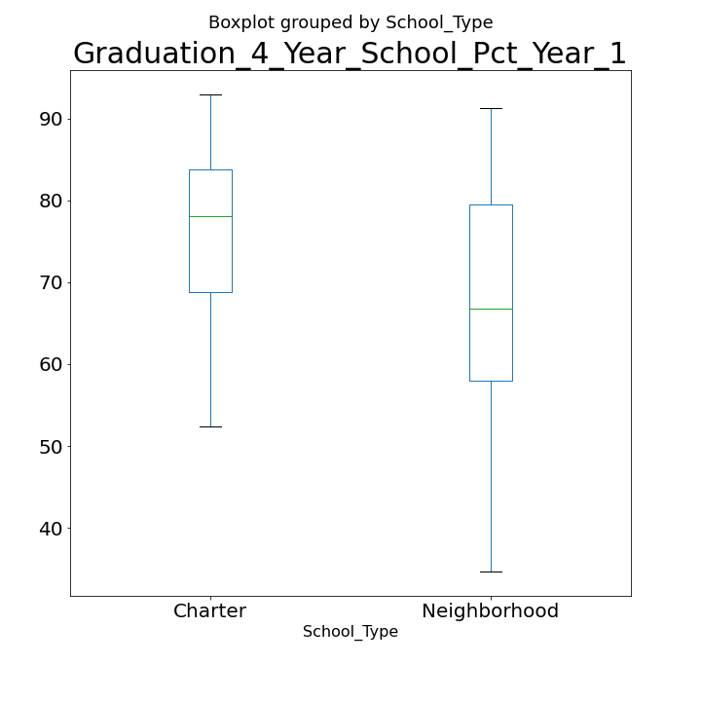
Is performance different at charter schools vs public schools in Chicago?

Slide 11

Conclusion:
We were surprised by our results on teacher salaries having low correlations with student performance. We were not surprised to find a correlation with teacher retention and student performance, which also shows a divide between charter schools (low retention) and neighborhood/selective schools (high retention).

Slide 12

Conclusion (cont’d):
We also found a strong difference in graduation rates and SAT scores between charter and neighborhood schools.

Slide 13
LennWaJoeC: Thank you!

